Slide 1
Counting
CSI 219 – Discrete Mathematics
Course teacher: Minhajul Bashir

Slide 2

The pigeonhole principle
If $k$ is a positive integer, and $k+1$ or more objects are placed into $k$ boxes, then there is at least one box that contains two or more objects

Slide 3

Generalized pigeonhole principle
If $N$ objects are placed into $k$ boxes, then there is at least one box containing at least $\left\lceil \frac{N}{k}\right\rceil$ objects

Slide 4
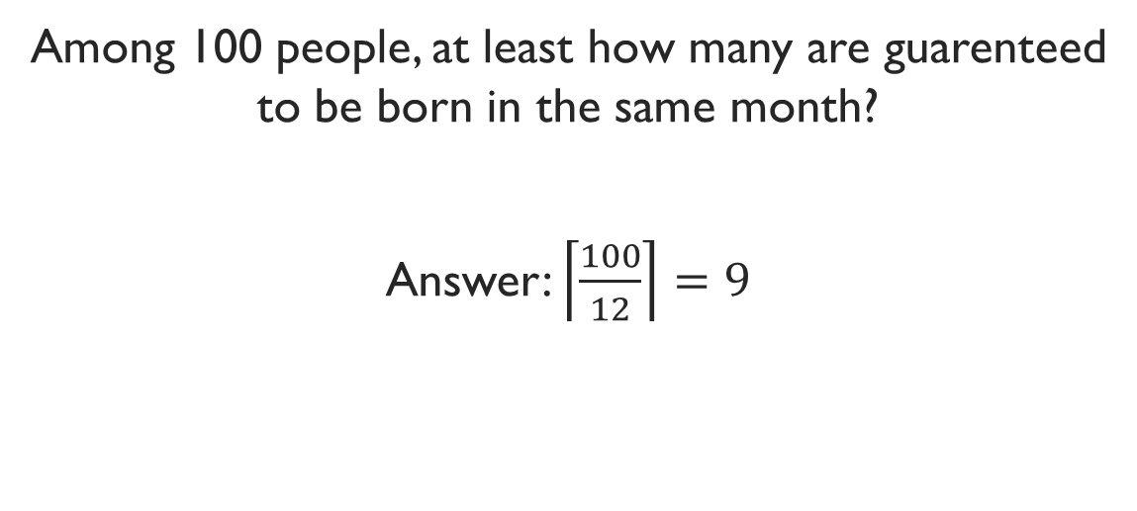
Example
Among 100 people, at least how many are guarenteed to be born in the same month?
Answer: $\left\lceil \frac{100}{12}\right\rceil =9$

Slide 5
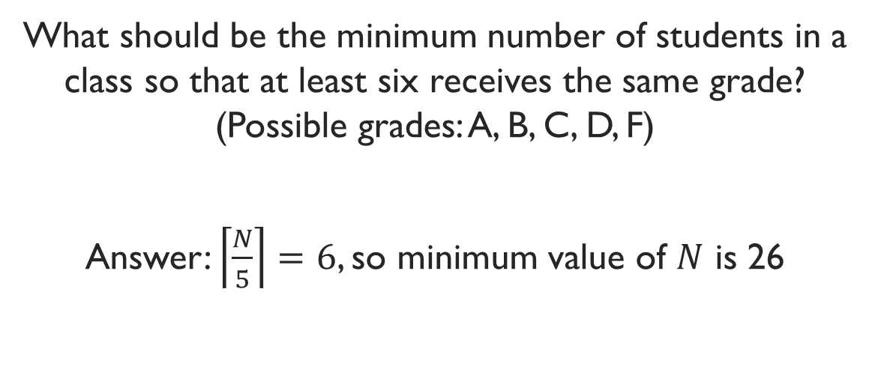
Example
What should be the minimum number of students in a class so that at least six receives the same grade? (Possible grades: A, B, C, D, F)
Answer: $\left\lceil \frac{N}{5}\right\rceil =6$, so minimum value of $N$ is 26

Slide 6
Exercise
How many cards must be selected from a standard deck of 52 cards to guarentee that at least three cards of the same suit are chosen?

Slide 7

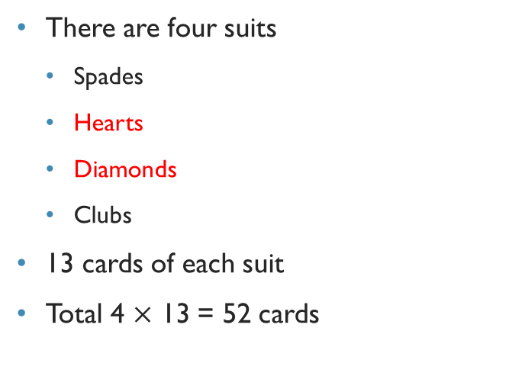
Cards tutorial
There are four suits
Spades
Hearts
Diamonds
Clubs
13 cards of each suit
Total 4 $×$ 13 = 52 cards

Slide 8
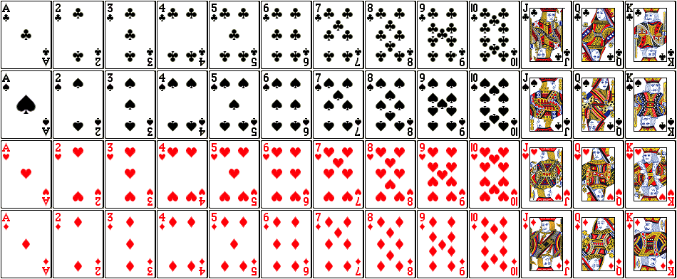

Slide 9
Cards tutorial
Many variants of playing cards
Single player: Solitaire, Free cell, Spider
Multiplayer: Hearts, Call bridge, IB
Gambling: Poker, Blackjack
Play yourself :P
CAUTION: Do not gamble with real money

Slide 10
Exercise
How many cards must be selected from a standard deck of 52 cards to guarentee that at least three cards of the same suit are chosen?

Slide 11
Exercise
How many cards must be selected from a standard deck of 52 cards to guarentee that we have at least three hearts?

Slide 12
Exercise
Telephone number format: NXX-NXX-XXXX, where N = 2 to 9, X = 0 to 9
25 million people in the state
At least how many area codes needed?

Slide 13
Exercise*
During a month of 30 days, a baseball team plays at least one game per day, but not more than 45 games in that month.
Show that there is a period of some number of consecutive days during which the team plays exactly 14 games.

Slide 14
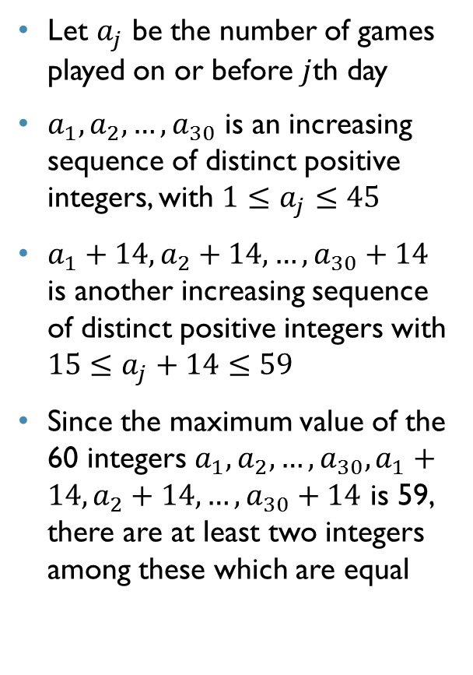
Let $a_{j}$ be the number of games played on or before $j$th day
$a_{1},a_{2},…,a_{30}$ is an increasing sequence of distinct positive integers, with $1≤a_{j}≤45$
$a_{1}+14,a_{2}+14,…,a_{30}+14$ is another increasing sequence of distinct positive integers with $15≤a_{j}+14≤59$
Since the maximum value of the 60 integers $a_{1},a_{2},…,a_{30},a_{1}+14,a_{2}+14,…,a_{30}+14$ is 59, there are at least two integers among these which are equal
During a month of 30 days, a baseball team plays at least one game per day, but not more than 45 games in that month.
Show that there is a period of some number of consecutive days during which the team plays exactly 14 games.

Slide 15
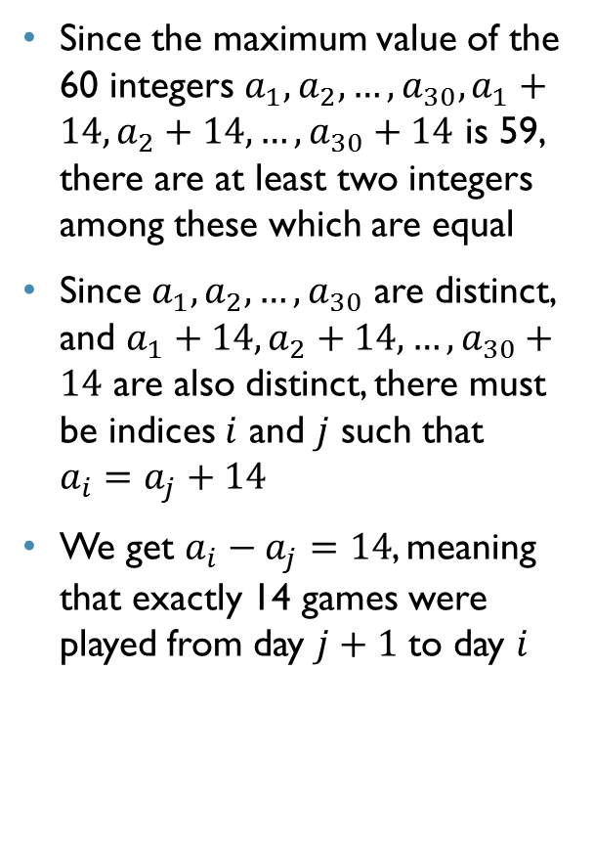
Since the maximum value of the 60 integers $a_{1},a_{2},…,a_{30},a_{1}+14,a_{2}+14,…,a_{30}+14$ is 59, there are at least two integers among these which are equal
Since $a_{1},a_{2},…,a_{30}$ are distinct, and $a_{1}+14,a_{2}+14,…,a_{30}+14$ are also distinct, there must be indices $i$ and $j$ such that $a_{i}=a_{j}+14$
We get $a_{i}−a_{j}=14$, meaning that exactly 14 games were played from day $j+1$ to day $i$
During a month of 30 days, a baseball team plays at least one game per day, but not more than 45 games in that month.
Show that there is a period of some number of consecutive days during which the team plays exactly 14 games.

Slide 16

Exercise*
Show that, among $n+1$ positive integers not exceeding $2n$, there must be an integer that divides one of the other integers.

Slide 17


Let us write each of the $n+1$ integers $a_{1},a_{2},…,a_{n+1}$ as a power of $2$ times an odd integer
Show that, among $n+1$ positive integers not exceeding $2n$, there must be an integer that divides one of the other integers.

Slide 18
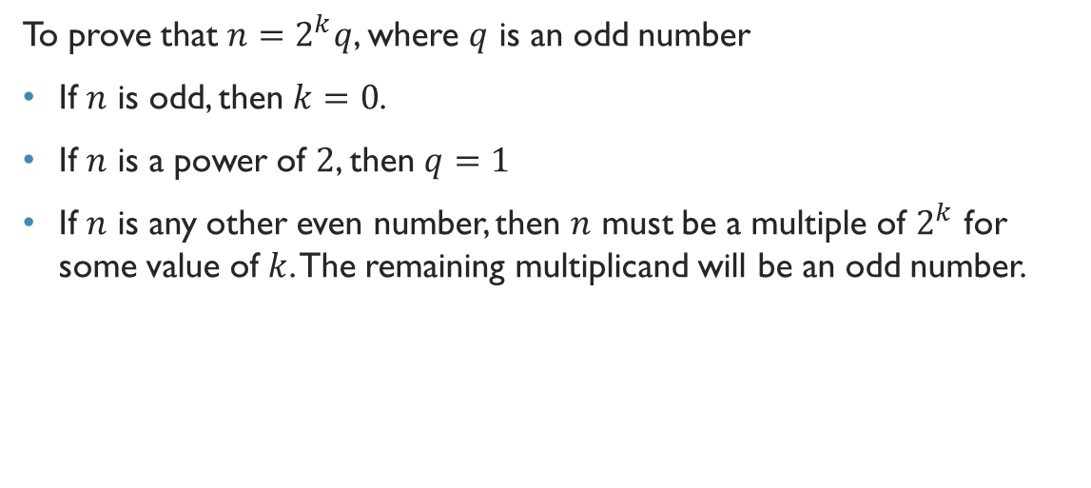
Representing an integer as a power of 2 times an odd number?
To prove that $n=2^{k}q$, where $q$ is an odd number
If $n$ is odd, then $k=0$.
If $n$ is a power of $2$, then $q=1$
If $n$ is any other even number, then $n$ must be a multiple of $2^{k}$ for some value of $k$. The remaining multiplicand will be an odd number.

Slide 19
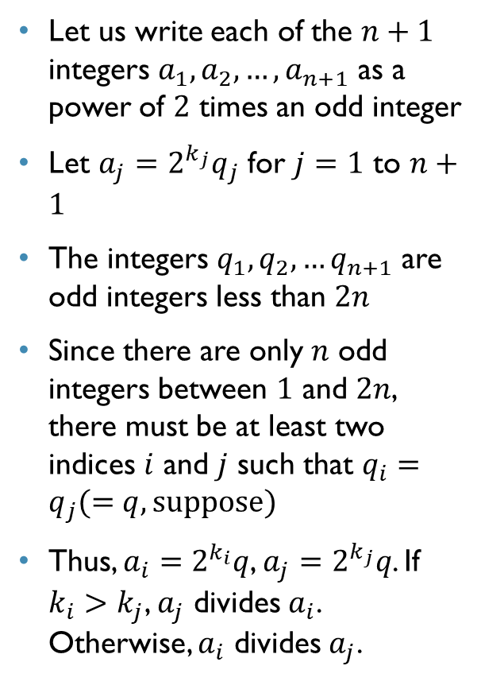
Let us write each of the $n+1$ integers $a_{1},a_{2},…,a_{n+1}$ as a power of $2$ times an odd integer
Let $a_{j}=2^{k_{j}}q_{j}$ for $j=1$ to $n+1$
The integers $q_{1},q_{2},…q_{n+1}$ are odd integers less than $2n$
Since there are only $n$ odd integers between $1$ and $2n$, there must be at least two indices $i$ and $j$ such that $q_{i}=q_{j}(=q, suppose)$
Thus, $a_{i}=2^{k_{i}}q$, $a_{j}=2^{k_{j}}q$. If $k_{i}>k_{j}$, $a_{j}$ divides $a_{i}$. Otherwise, $a_{i}$ divides $a_{j}$.
Show that, among $n+1$ positive integers not exceeding $2n$, there must be an integer that divides one of the other integers.

